Slide 1
Lecture # 21-22
Dr. M. Nadeem

Slide 2
Sorting
Iterative methods:
Insertion sort
Bubble sort
Selection sort
2, 3, 4, 5, 6, 7, 8, 9, 10, J, Q, K, A
Divide and conquer
Merge sort
Quicksort
Non-comparison methods
Counting sort
Radix sort
Bucket sort

Slide 3
Bubble Sort
Idea:
Repeatedly pass through the array
Swaps adjacent elements that are out of order
Easier to implement, but slower than Insertion sort
i
1
2
3
n
8
4
6
9
2
3
1
j

Slide 4
Summary of Steps of Bubble Sort
Compare each pair of adjacent elements from the beginning of an array and, if they are in reversed order, swap them.
If at least one swap has been done, repeat step 1

Slide 5
Bubble Sort
Alg.: BUBBLESORT(A)
for i ← 1 to length[A]-1
do for j ← 1 to length[A]-i
do if A[j] > A[j +1]
then exchange A[j] ↔ A[j+1]
Notes:
Passes

Slide 6
Bubble sort Analysis
To be done in the class
Notes:
Note: in summation use i=1 to (n-1)
NOTE: C1(n+1)+c2(1+1+1+1+……..+1(n-1 times))
C1(n+1)+c2(n-1)=O(n)
∑(n) where i=1 to n is equal to =n*n since n is constant and i is variable so add 1+1+….+1(n times)=n
∑(i) where i=1 to n is equal to =n(n+1)/2 since n is constant and i is variable so add 1+2+3+….+n=n(n+1)/2

Slide 7
Bubble Sort
Worst case О(n²)
Best case Ω(n)
Average case Ѳ(n²)
Notes:
In best case during implementation use flag if no swapping its mean numbers are given in already sorted order so terminate both loops after 1 time execution of inner loop to test the value of flag that will run in O(n) time

Slide 8
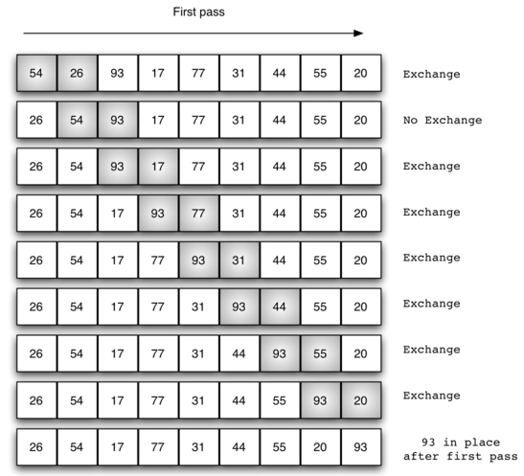
Example (Sort: 54,26,93,17,77,31,44,55,20)

Slide 9
Example
Sort the following data using Bubble Sort
8
4
6
9
2
3
1

Slide 10
Selection Sort
Summary of Steps
Find the smallest element in the array
Exchange it with the element in the first position
Find the second smallest element and exchange it with the element in the second position
Continue until the array is sorted

Slide 11
Selection Sort
The algorithm works as follows:
Find the minimum value in the list
Swap it with the value in the first position
Repeat the steps above for the remainder of the list (starting at the second position and advancing each time)

Slide 12
Example
Step 1
8
4
6
9
2
3
1
1
2
3
4
9
6
8
Step 2
1
4
6
9
2
3
8
1
2
3
4
6
9
8
Step 3
Step 7
1
2
6
9
4
3
8
1
2
3
4
6
8
9
Sorted Array
1
2
3
9
4
6
8
1
2
3
4
6
8
9

Slide 13
Selection Sort
Alg.: SELECTION-SORT(A)
n ← length[A]
for j ← 1 to n - 1
smallest ← j
for i ← j + 1 to n
if A[i] < A[smallest]
then smallest ← i
exchange A[j] ↔ A[smallest]

Slide 14
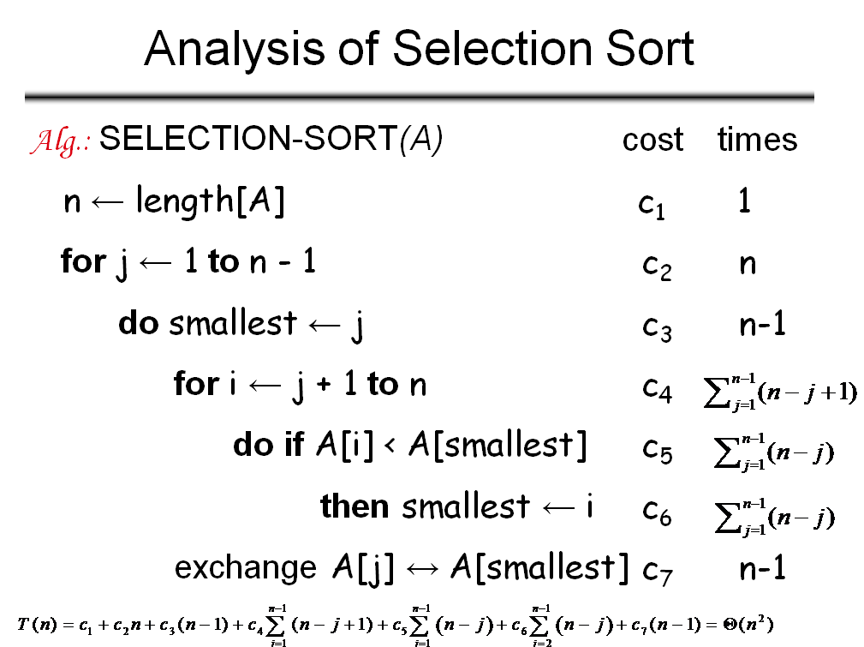
Notes:
Running time for example
For i=2 to n n-1+1
i++ n-1
Now: for i=j+1 to n we have (n-j) since j+1 is inclusive as in case of 2 as above, so n-j+1 where +1 is loop extra iteration

Slide 15
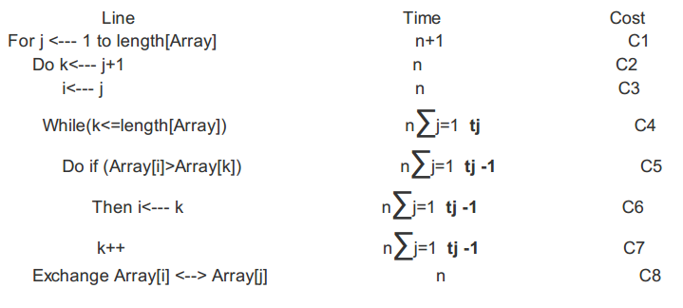
Selection Sort

Slide 16
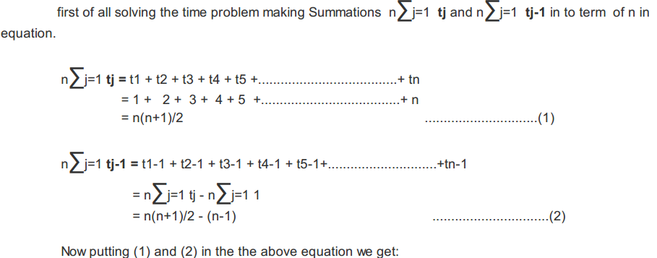
Selection Sort
Notes:
Second loop should go to n-1
tj is time factor

Slide 17
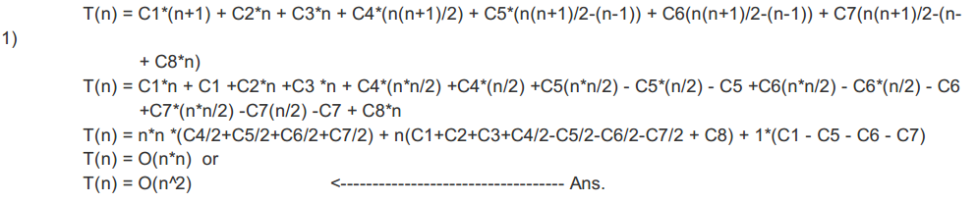
Selection Sort

Slide 18
Example
Dry Run the Selection-Sort algorithm on the following example
7, -5, 2, 16, 4

Slide 19
Selection Sort
Worst case
О(n²)
Best case
Ω(n²)
Average case
Ѳ(n²)

Slide 20
Insertion Sort
Idea: like sorting a hand of playing cards
Start with an empty left hand and the cards facing down on the table.
Remove one card at a time from the table, and insert it into the correct position in the left hand
compare it with each of the cards already in the hand, from right to left
The cards held in the left hand are sorted
these cards were originally the top cards of the pile on the table

Slide 21
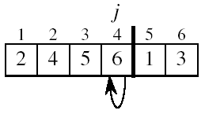
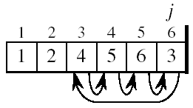
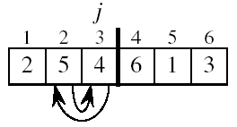
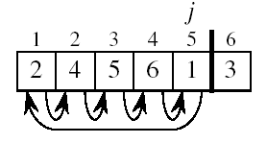
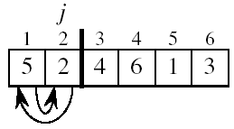

Example

Slide 22
Summary
Insertion sort algorithm somewhat resembles selection sort.
Array is imaginary divided into two parts - sorted one and unsorted one.
At the beginning, sorted part contains first element of the array and unsorted one contains the rest.
At every step, algorithm takes first element in the unsorted part and inserts it to the right place of the sorted one.
When unsorted part becomes empty, algorithm stops.

Slide 23
INSERTION-SORT
Alg.: INSERTION-SORT(A)
for j ← 2 to n
key ← A[ j ]
i ← j - 1
while i > 0 and A[i] > key
A[i + 1] ← A[i]
i ← i – 1
A[i + 1] ← key
1
2
3
4
5
6
7
8
a₁
a₂
a₃
a₄
a₅
a₆
a₇
a₈
key
Notes:
A[i + 1] ← A[i] means move that number one step forward and reduce the index because it moves from j-1 toward zero (0)….since it is the efficient way to insert number in less number of iterations
J=2 since 1 element is always a sorted element
while i > 0 and A[i] > key it searches for proper insertion location in backward direction from unsorted to sorted list
Key and i are based on main index j, key is for value and i is for index since value and index are important in sorting, index i is inserting position index, key is for value taken from unsorted list and to be included in sorted list

Slide 24
Example
Dry Run the Insertion Sort algorithm on the following example
7, -5, 2, 16, 4

Slide 25
Analysis of Insertion Sort
INSERTION-SORT(A)
for j ← 2 to n
do key ← A[ j ]
i ← j - 1
while i > 0 and A[i] > key
do A[i + 1] ← A[i]
i ← i – 1
A[i + 1] ← key
cost times
c₁ n
c₂ n-1
c₃ n-1
c₄
c₅
c₆
c₇ n-1
Notes:
J=2 to n is same as j=1 to n-1
2 is included what is not included is 1 so it will run n-1+1 time (+1 is extra iteration for false condition)

Slide 26
Best Case Analysis
The array is already sorted
A[i] ≤ key upon the first time the while loop test is run (when i = j -1)
t_{j} = 1(because in first comparison condition is false so just 1 iteration)
T(n) = c₁n + c₂(n -1) + c₄(n -1) + c₅(n -1) + c₈(n-1) = (c₁ + c₂ + c₄ + c₅ + c₈)n + (c₂ + c₄ + c₅ + c₈)
= an + b = Θ(n)
“while i > 0 and A[i] > key”
Notes:
For best case all elements are in a sequence and so only one comparison per time that will make summation result equal to (n-1=2+3+4+5…..+n)

Slide 27
Worst Case Analysis
The array is in reverse sorted order
Always A[i] > key in while loop test
Have to compare key with all elements to the left of the j-th position ⇒ compare with j-1 elements ⇒ t_{j} = j
a quadratic function of n
T(n) = Θ(n²) order of growth in n²
“while i > 0 and A[i] > key”
Notes:
By Mathematical Induction
∑(j-1)=∑(j)-∑(1) = n(n+1)/2-1-(n-1) = (n^2+n-2n-2+2)/2 =(n^2+n-2n)/2 =(n^2-n)/2=n(n-1)/2

Slide 28
Insertion Sort
Worst case
О(n²)
Best case
Ω(n)
Average case
Ѳ(n²)

Slide 29
Divide-and-Conquer
Divide the problem into a number of subproblems
Similar sub-problems of smaller size
Conquer the sub-problems
Solve the sub-problems recursively
Sub-problem size small enough ⇒ solve the problems in straightforward manner
Combine the solutions to the sub-problems
Obtain the solution for the original problem

Slide 30
Merge Sort Approach
To sort an array A[p . . r]:
Divide
Divide the n-element sequence to be sorted into two subsequences of n/2 elements each
Conquer
Sort the subsequences recursively using merge sort
When the size of the sequences is 1 there is nothing more to do
Combine
Merge the two sorted subsequences

Slide 31
Merge Sort Approach
Merge sort is based on the divide-and-conquer paradigm.
Divide Step
If a given array A has zero or one element, simply return; it is already sorted. Otherwise, split Array [p .. r] into two sub arrays A[p .. q] and A[q + 1 .. r], each containing about half of the elements of A[p .. r].
Conquer Step
Conquer by recursively sorting the two sub arrays A[p .. q] and A[q + 1 .. r].

Slide 32
Merge Sort Approach
Combine Step
Combine the elements back in A[p .. r] by merging the two sorted sub arrays A[p .. q] and A[q + 1 .. r] into a sorted sequence. To accomplish this step, we will define a procedure MERGE (A, p, q, r).
Note:
The recursion bottoms out when the sub array has just one element, so that it is trivially sorted.

Slide 33
Merge Sort Example
99 | 6 | 86 | 15 | 58 | 35 | 86 | 4 | 0

Slide 34
Merge Sort Example
99 | 6 | 86 | 15 | 58 | 35 | 86 | 4 | 0
99 | 6 | 86 | 15
58 | 35 | 86 | 4 | 0

Slide 35
Merge Sort Example
99 | 6 | 86 | 15 | 58 | 35 | 86 | 4 | 0
99 | 6 | 86 | 15
58 | 35 | 86 | 4 | 0
99 | 6
86 | 15
58 | 35
86 | 4 | 0

Slide 36
Merge Sort Example
99 | 6 | 86 | 15 | 58 | 35 | 86 | 4 | 0
99 | 6 | 86 | 15
58 | 35 | 86 | 4 | 0
99 | 6
86 | 15
58 | 35
86 | 4 | 0
99
6
86
15
58
35
86
4 | 0

Slide 37
Merge Sort Example
99 | 6 | 86 | 15 | 58 | 35 | 86 | 4 | 0
99 | 6 | 86 | 15
58 | 35 | 86 | 4 | 0
99 | 6
86 | 15
58 | 35
86 | 4 | 0
99
6
86
15
58
35
86
4 | 0
4
0

Slide 38
Merge Sort Example
99
6
86
15
58
35
86
0 | 4
Merge
4
0

Slide 39
Merge Sort Example
6 | 99
15 | 86
58 | 35
0 | 4 | 86
99
6
86
15
58
35
86
0 | 4
Merge

Slide 40
Merge Sort Example
6 | 15 | 86 | 99
0 | 4 | 35 | 58 | 86
6 | 99
15 | 86
58 | 35
0 | 4 | 86
Merge

Slide 41
Merge Sort Example
0 | 4 | 6 | 15 | 35 | 58 | 86 | 86 | 99
6 | 15 | 86 | 99
0 | 4 | 35 | 58 | 86
Merge

Slide 42
Merge Sort Example
0 | 4 | 6 | 15 | 35 | 58 | 86 | 86 | 99

Slide 43
Merge Sort
p
q
r
1
2
3
4
5
6
7
8
Alg.: MERGE-SORT(A, p, r)
if p < r Check for base case
then q ← ⎣(p + r)/2⎦ Divide
MERGE-SORT(A, p, q) Conquer
MERGE-SORT(A, q + 1, r) Conquer
MERGE(A, p, q, r) Combine
Initial call: MERGE-SORT(A, 1, n)
5
2
4
7
1
3
2
6
Notes:
Floor function

Slide 44
Merge - Pseudocode
p
q
r
Alg.: MERGE(A, p, q, r)
Compute n₁ and n₂
Copy the first n₁ elements into L[1 . . n₁ + 1] and the next n₂ elements into R[1 . . n₂ + 1]
L[n₁ + 1] ← ∞; R[n₂ + 1] ← ∞
i ← 1; j ← 1
for k ← p to r
do if L[ i ] ≤ R[ j ]
then A[k] ← L[ i ]
i ←i + 1
else A[k] ← R[ j ]
j ← j + 1
1
2
3
4
5
6
7
8
2
4
5
7
1
2
3
6
n₁
n₂
p
q
L
2
4
5
7
∞
q + 1
r
R
1
2
3
6
∞
Notes:
Why we are using Infinity, because if we reach at the end of the first array then after that the last element will be big enough for the sake of comparison.
i is used to control the first array and j is controlling the second array. K is controlling the main array. See p,q,r in L and R array

Slide 45
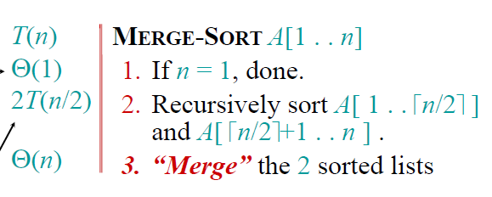
Analyzing the merge Sort
Best case=worst case=average case = O(n log n)

Slide 46
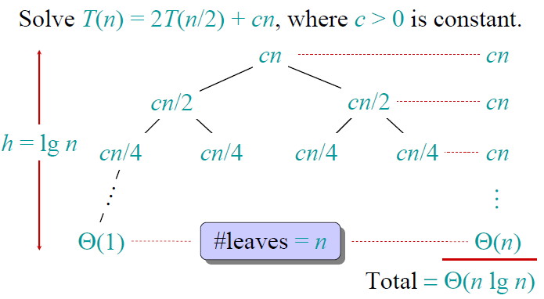
Analyzing the merge Sort (Recursion tree)

Slide 47
Example
Given Array
2 | 5 | 8 | 4 | 7 | 6 | 1 | 9 | 3
First Sub Array
Second Sub Array
2 | 5 | 8 | 4
7 | 6 | 1 | 9 | 3

Slide 48
Example
Sorted Array Array
First Sorted Array
First Sorted Array
2 | 4 | 5 | 8
1 | 3 | 6 | 7 | 9

Slide 49
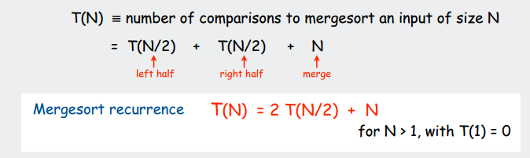
Analysis

Slide 50
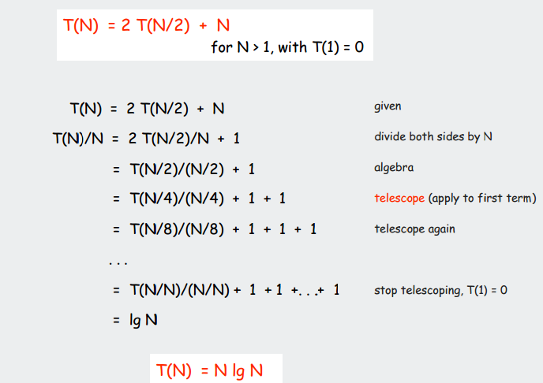
Proof
Using Telescoping Method
Notes:
Log N is actually number of times value “1” appears in final equation
T(N)/N=log(n) it implies that T(N)=N.log(N)
Note: number of values 1’s is app. Equal to log(N) where log is logarithm of base 2
Suppose log2(16)=2^4 that is power 4 and its result will be 4 so total 4 division steps required since it is divide and conquer approach
T(1)=0 means time required to divide and conquer 1 element is equal to 0

Slide 51
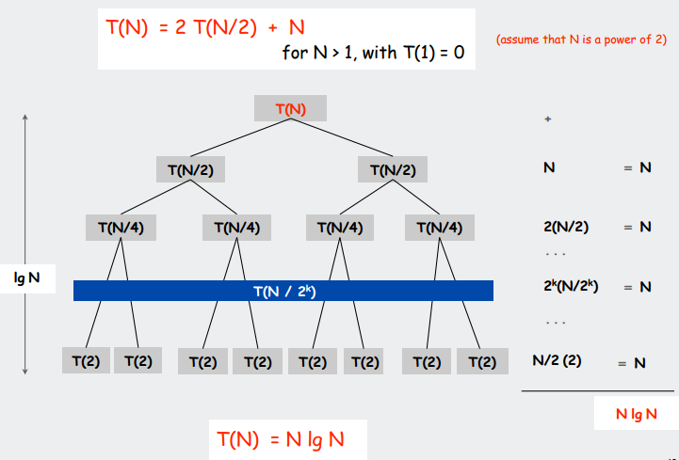
Using Recursion Tree Method
Notes:
Assume N is power for 2 means easy division that is 2,4,8,16,32,……….

Slide 52
Quick Sort
It is one of the fastest sorting algorithms known and is the method of choice in most sorting libraries.
Quicksort is based on the divide and conquer strategy. Here is the algorithm:

Slide 53
Quicksort
A[p…q]
≤
A[q+1…r]
Sort an array A[p…r]
Divide
Partition the array A into 2 subarrays A[p..q] and A[q+1..r], such that each element of A[p..q] is smaller than or equal to each element in A[q+1..r]
The index (pivot) q is computed
Conquer
Recursively sort A[p..q-1] and A[q+1..r] using Quicksort
Combine
The entire array is now sorted

Slide 54
QUICK SORT
Alg. : QUICKSORT(A, p, r)
if p < r
then q ← PARTITION(A, p, r)
QUICKSORT(A, p, q - 1)
QUICKSORT(A, q + 1, r)
The pivot is no longer included in any of the subarrays!!

Slide 55
PARTITION(array A, int p, int r)
0. Select Pivot and exchange it to first position of the array
1 x ← A[p]
2 q ← p
3 for s ← p + 1 to r
4 do if (A[s] < x)
5 then q ← q + 1
6 swap A[q] with A[s]
7 swap A[p] with A[q]
8 return q
Notes:
X is pivot, s is reading elements of array starting from second element since first element is pivot, p is first location and r is the last location of array A, q is at location that is less then pivot, q shows less than or equal to pivot value index, that is it is controlling the replacement (that which number to be swapped or not based on the pivot comparison) , actually q is controlling the pivot position that at he end will divide the array in two parts right part and left part of pivot. X is pivot value, q is pivot position controlling index, p is starting index, s scans numbers in the array

Slide 56
Example
5 | 3 | 8 | 6 | 4 | 7 | 3 | 1

Slide 57
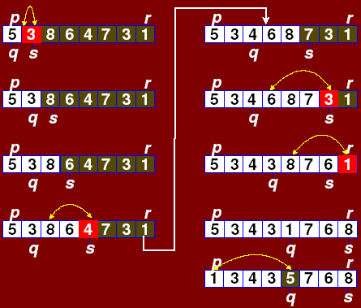

Slide 58
Analysis of Quick sort
The running time of quicksort depends heavily on the selection of the pivot. If the rank (index value) of the pivot is very large or very small then the partition (BST) will be unbalanced.
Since the pivot is chosen randomly in our algorithm, the expected running time is O(n log n).
The worst case time, however, is O(n²). Luckily, this happens rarely.

Slide 59
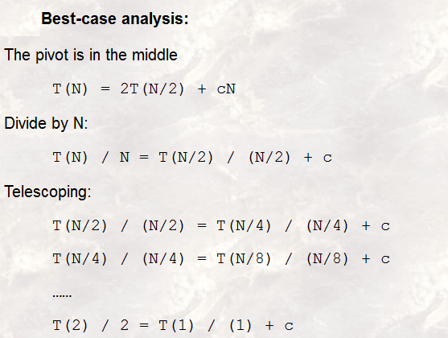
Notes:
Best case mean suppose pivot is middle number n it divides both lists in approx. equal halves.
C.N is time to merge N elements and vice versa
Constant C is used in Quick sort because at each iteration it sorts 1 element(Pivot) and so remaining iterations are (N-1) and vice versa

Slide 60
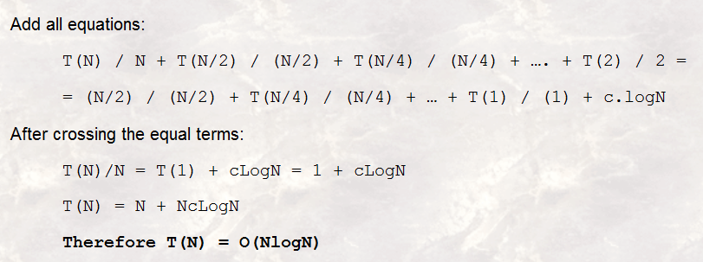
Notes:
T(1)=1 in quick sort since 1 elements is sorted and so this will move in combining the elements T
C is adding till LogN times so CLogN

Slide 61
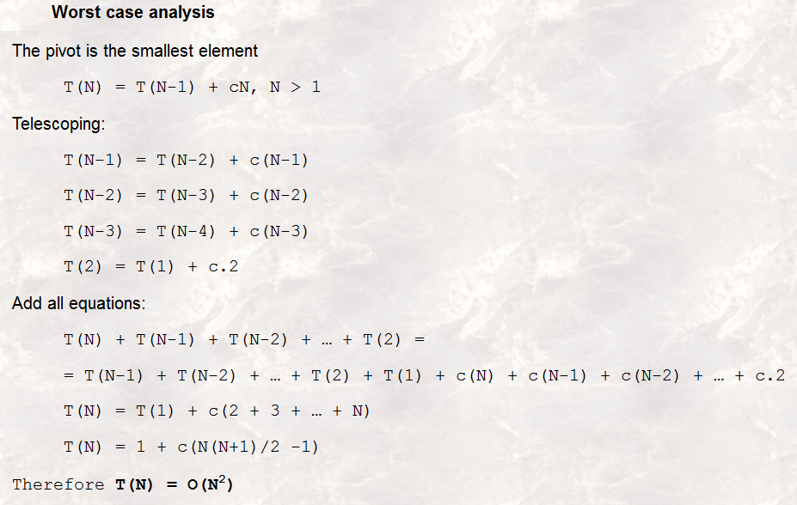
(Cancel similar terms on both sides)
Notes:
cN is time to divide/combine N elements, c(N-1) is time to divide/combine N-1 elements, c(N-2) is time to divide N-2 elements etc ……..c.2 is time to divide two elements, since algo applies on at least two elements
Cancel similar terms on both sides
T(1)=1 is because of pivot, suppose 2 elements, then declare 1 as pivot then to divide for pivot is T(1) and then combine these 2

Slide 62
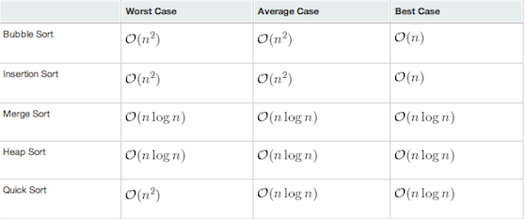
Running Times

